Slide 1
Lesson objective
Need whiteboards and calculators.
Title: Probability review
Aim:
Calculate circumference and area of circles
Determine probability from represented data
Plan:
Review circumference and area
Venn diagrams extended

Slide 2

RADIUS

Slide 3
DIAMETER

Slide 4
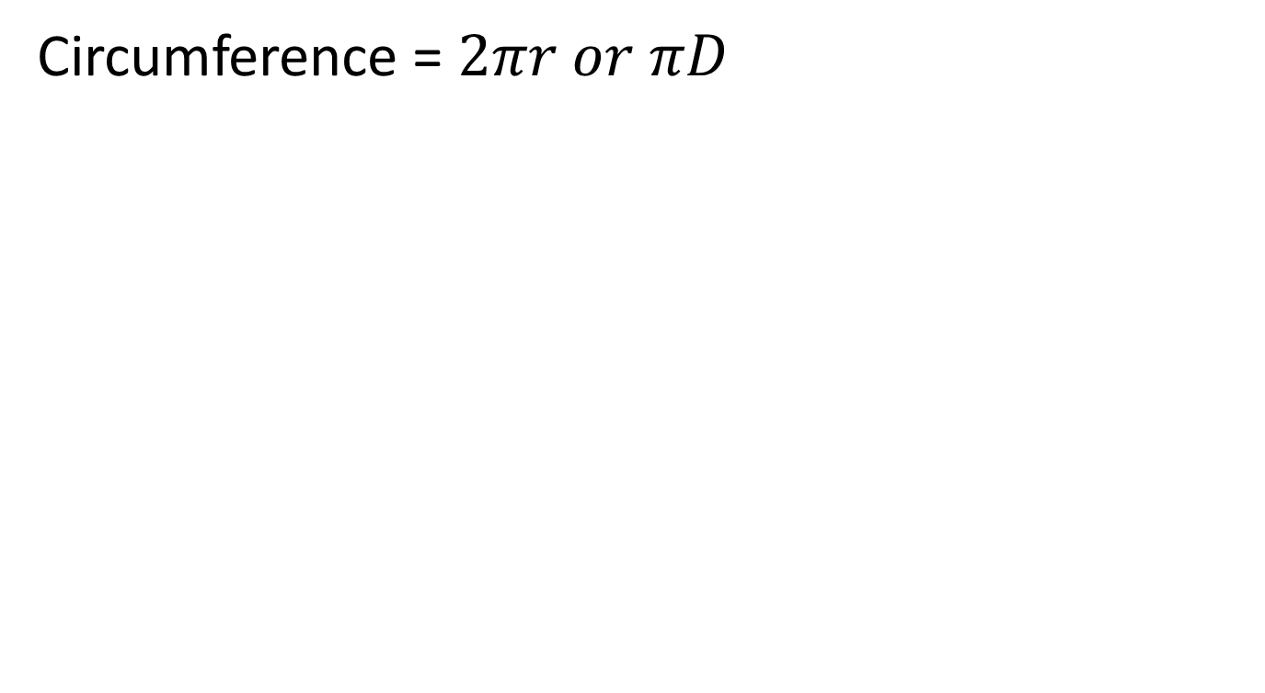
I do
Write the rule
Substitute numbers
Solve
Circumference = $2πr or πD$
5cm
6cm

Slide 5
we do
Write the rule
Substitute numbers
Solve
Circumference = $2πr or πD$
7cm
8cm

Slide 6
Whiteboards
Calculate the circumference.
diameter
3cm

Slide 7
Whiteboards
Calculate the circumference.
6cm

Slide 8
Whiteboards
Calculate the circumference.
3.5cm

Slide 9
Whiteboards
Calculate the circumference.
12cm

Slide 10

I do
Write the rule
Substitute numbers
Solve
Area$= π × {radius}^{2}$
5cm
6cm

Slide 11
we do
Write the rule
Substitute numbers
Solve
Area$= π × {radius}^{2}$
7cm
8cm

Slide 12
Whiteboards
Calculate the Area.
diameter
3cm

Slide 13
Whiteboards
Calculate the Area.
6cm

Slide 14
Whiteboards
Calculate the Area.
3.5cm

Slide 15
Whiteboards
Calculate the Area.
12cm

Slide 16
Terminology
And
Or
In probability “and” describes features that must be satisfied.
E.g. A person who has blue eyes and blonde hair.
Universal set: total number of something being represented
In probability “or” can be inclusive or exclusive.
E.g. A person who has blonde hair or blue eyes. (inclusive of both)
E.g. a person who has blue eyes or blonde hair but not both (Exclusive)

Slide 17
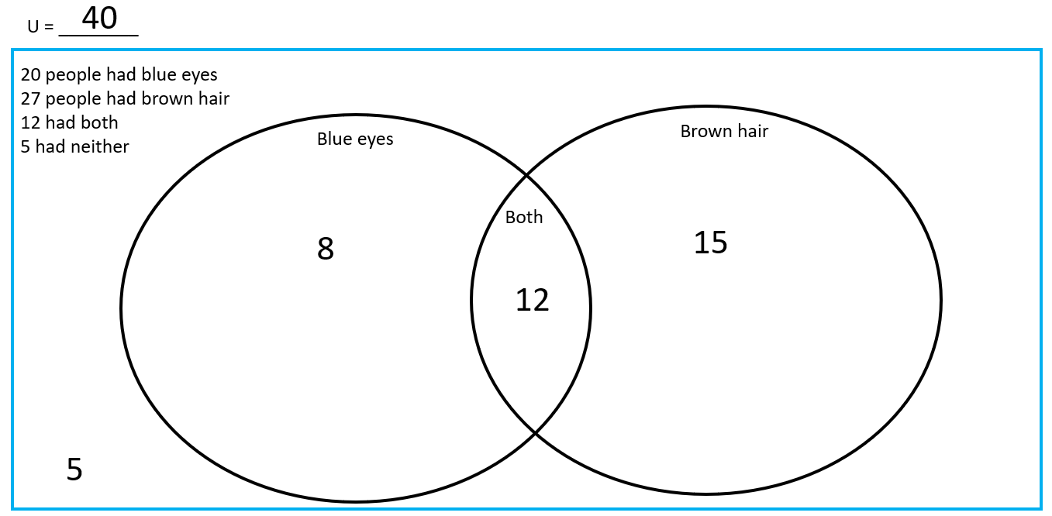
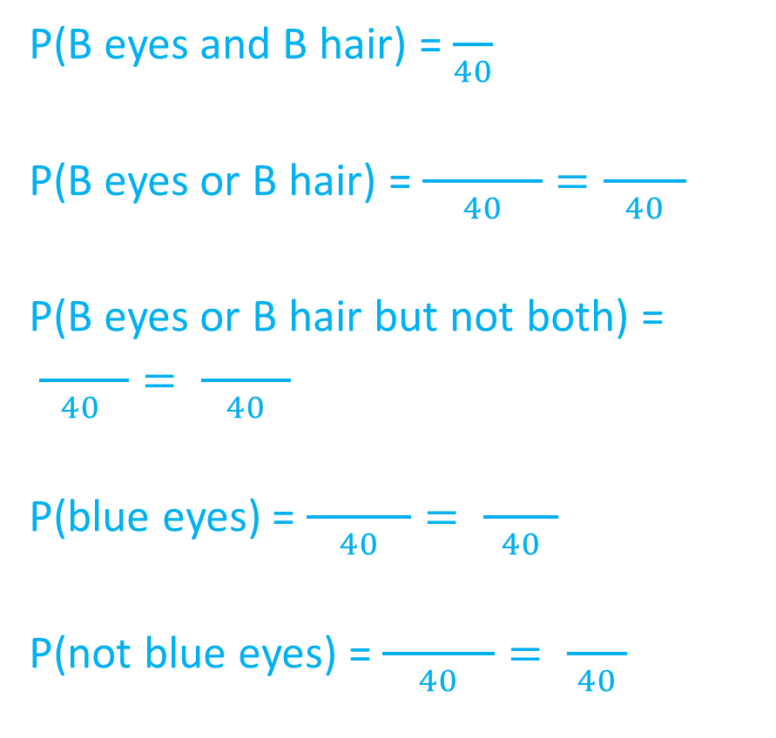
P(B eyes and B hair) = $\frac{ }{40}$
P(B eyes or B hair) = $\frac{ }{40}=\frac{ }{40}$
P(B eyes or B hair but not both) =
$\frac{ }{40 }= \frac{ }{40}$
P(blue eyes) = $\frac{ }{40}= \frac{ }{40}$
P(not blue eyes) = $\frac{ }{40}= \frac{ }{40}$
Sketch Venn diagram onto NOTES page.
Notes:
Students to copy Venn diagram when finished and use to create notes

Slide 18
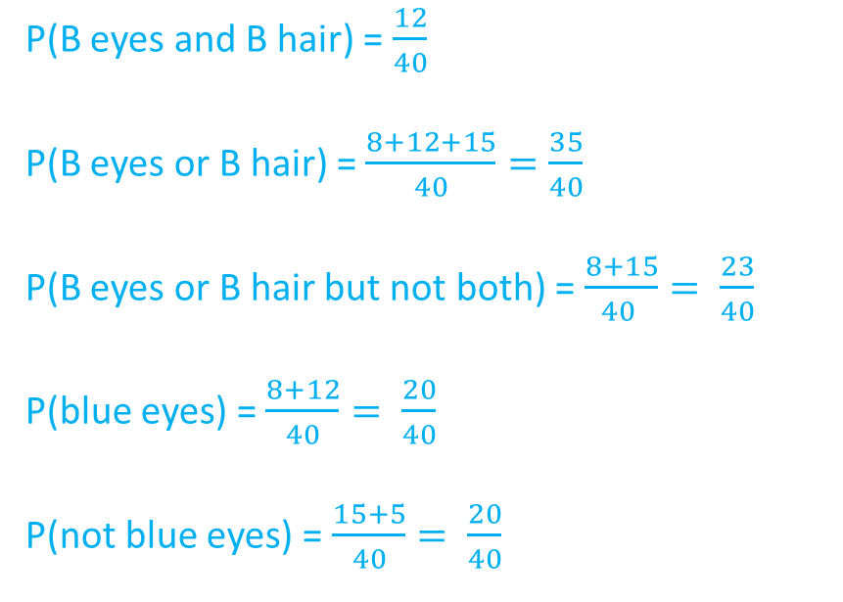
Notes
Universal set = total number represented in diagram
Notation
Example
P(A and B)
P(A or B)
P(A or B not both)
P(A)
P(A’) – complimentary event (the opposite of something)
P(B eyes and B hair) = $\frac{12}{40}$
P(B eyes or B hair) = $\frac{8+12+15}{40}=\frac{35}{40}$
P(B eyes or B hair but not both) = $\frac{8+15}{40 }= \frac{23}{40}$
P(blue eyes) = $\frac{8+12}{40}= \frac{20}{40}$
P(not blue eyes) = $\frac{15+5}{40}= \frac{20}{40}$

Slide 19
Venn Diagrams – An Example
We do
The Venn diagram below shows two events D and F.
Find: a) P(D and F) b) P(Not D) c) P(D only)
d) P(D or F) e) P(Not D or F)
U =
D
F
10
6
5
9

Slide 20
Venn Diagrams
You do: whiteboards
The Venn diagram below shows what some people had for breakfast.
C is the event that they had cereal
O is the event that they had OJ
C
O
19
35
42
Selecting a person at random:
P(had Cereal AND OJ)
P(C or OJ)
P(only OJ)
P(not OJ)
P(C or OJ but NOT both)
4

Slide 21
Language of probability!
U = 100
A person selected at random, find the probability that they:
P(owned 1 animal)
P(owned at least 2)
P(owned cat or horse)
P(owned cow or cat but not both)
P(did not have these animals)
Owes a cat
Owns a horse
12
21
9
4
9
11
35/100
45/100
66/100
58/100
20/100
14
20
Owns a cow

Slide 22




Example
A vet surveys 100 of her clients. She finds that:
25 own dogs 15 own cats and dogs 11 own dogs and tropical fish
53 own cats 10 own cats and tropical fish 7 own dogs, cats and tropical fish
40 own tropical fish
A client is chosen at random, find the probability that the client:
a) Owns dogs only.
b) Does not own tropical fish.
c) Does not own dogs, cats or tropical fish.
11 – 7 = 4
25-(8+7+4)=6
15 – 7 = 8
53-(8+7+3)=35
40–(4+7+3)= 26
10 – 7 = 3
$$ξ$$
D
C
Don’t forget to complete the full set:
6+8+35+4+7+3+26 = 89
100 – 89 = 11
8
6
35
7
4
3
26
F
11

Slide 23
Whiteboards: have a go
70 people were asked where they had travelled this year.
18 people said they went to Busselton and Bali
19 people said they wen to Perth and Busselton
11 people said they had been to Busselton, Perth and Bali.
20 people went to Perth and bali
A total of 37 people have been to Bali.
13 people only went to Perth
Everyone had been to at least 1 place.
U = 70
Buss
Bali
Perth

